Slide 1



DEPARTMENT OF CSE (ARTIFICIAL INTELLIGENCE AND MACHINE LEARNING)
EXAM SEATING AUTO GENERATION SYSTEM
A.ARUN KUMAR - 217R1A66D2
A.MOHIT VENKAT SAI - 217R1A66D0
R.VEDHAVYAS - 217R1A66H7
Under the guidance of
KORIPALLI NAGAMANI
ASSISTANT PROFESSOR

Slide 2

TABLE OF CONTENTS
1
Abstract
Existing System
Disadvantages
Proposed System
Advantages
System Architecture
Use case Diagram
Class Diagram
Sequence Diagram
Algorithms
Dataset
Screenshots and project execution
Performance metrics
Results Analysis(Graph)
Conclusion and Future Scope
Any Queries

Slide 3
2
ABSTRACT
The Exam Hall Seating Arrangement system aims to automate the process of allocating seats for examinations, reducing manual work for administrators and providing convenience for students.
The system comprises a secure login mechanism for administrators and students, an admin panel for managing exam details and student lists, and an algorithm to automatically assign seats based on various factors such as availability and special requirements.
The system offers flexibility for administrators to customize seating arrangements and ensures scalability and performance to handle large numbers of students and exam sessions
Security measures are implemented to protect sensitive data, and thorough testing and feedback collection are conducted to enhance the system's functionality and user experience.
Overall, the Exam Hall Seating Arrangement system streamlines the seat allocation process, improving efficiency and convenience for all stakeholders involved in the examination process.

Slide 4
3
EXISTING SYSTEM
The existing practice is the arrangement of seats for examinations manually by the exam cell faculty, with registered students and exam details provided by the university.
Which Includes:
Process the number of students who are appearing
Schedule Exams orderly and accordingly
Review the No of classrooms and Dept’s available in the time of exam
Allocating accordingly

Slide 5
4
DISADVANTAGES
The manual arrangement of seats can be time consuming,especially for large classes or multiple exam sessions
Human errors such as double seats or overlooking specific requirements can occur
Any changes or updates in exam schedules,or specific requirements may not be instantly reflected in the seating arrangement system.

Slide 6
5
PROPOSED SYSTEM
An automated exam seat arrangement system that aims to streamline the prcess of assigning seats for students taking exams
METHODOLOGIES
Exam cell requirement gathering
user-friendly design for seating arrangement
security measures for exam data

Slide 7
ADVANTAGES
6
The proposed system automates the entire process of scheduling exams and assigning seats, significantly reducing the time and effort required by administrators.
The system automatically detects and resolves scheduling conflicts, such as overlapping exam times or double bookings of rooms.
The system allocates seats based on predefined criteria and constraints, ensuring fairness and impartiality in the seating arrangement process.
The system optimizes the use of available exam rooms by analyzing data and efficiently assigning seats. This maximizes room utilization, prevents overcrowding, and ensures that resources are used effectively.

Slide 8
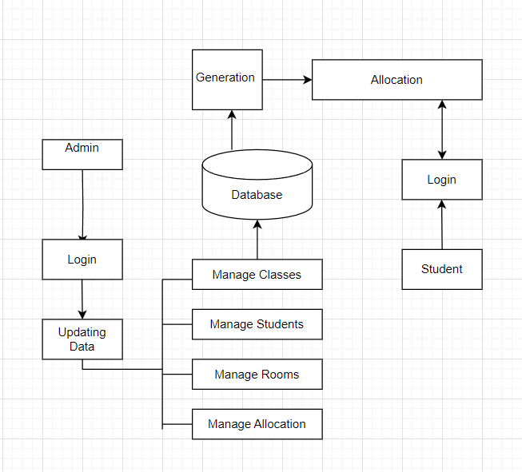
7
SYSTEM ARCHITECTURE

Slide 9
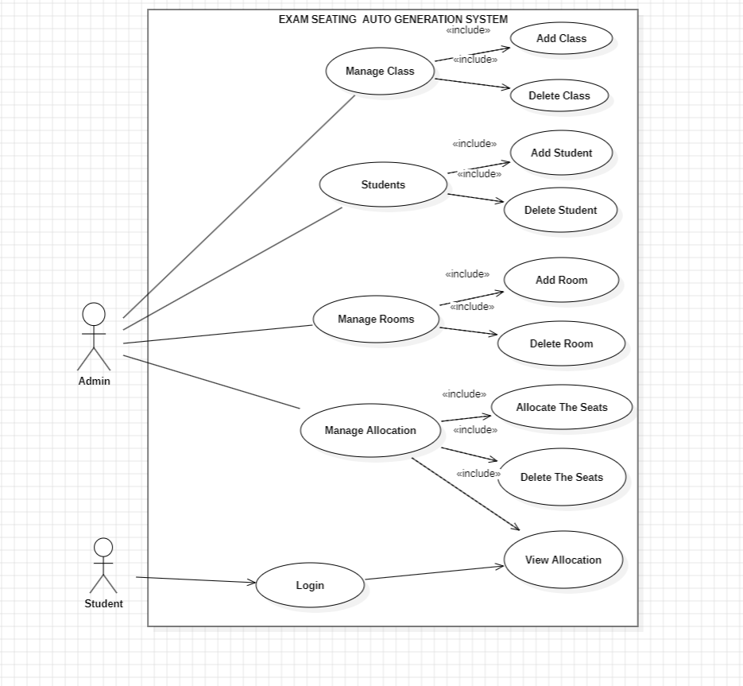
USE CASE DIAGRAM
8

Slide 10
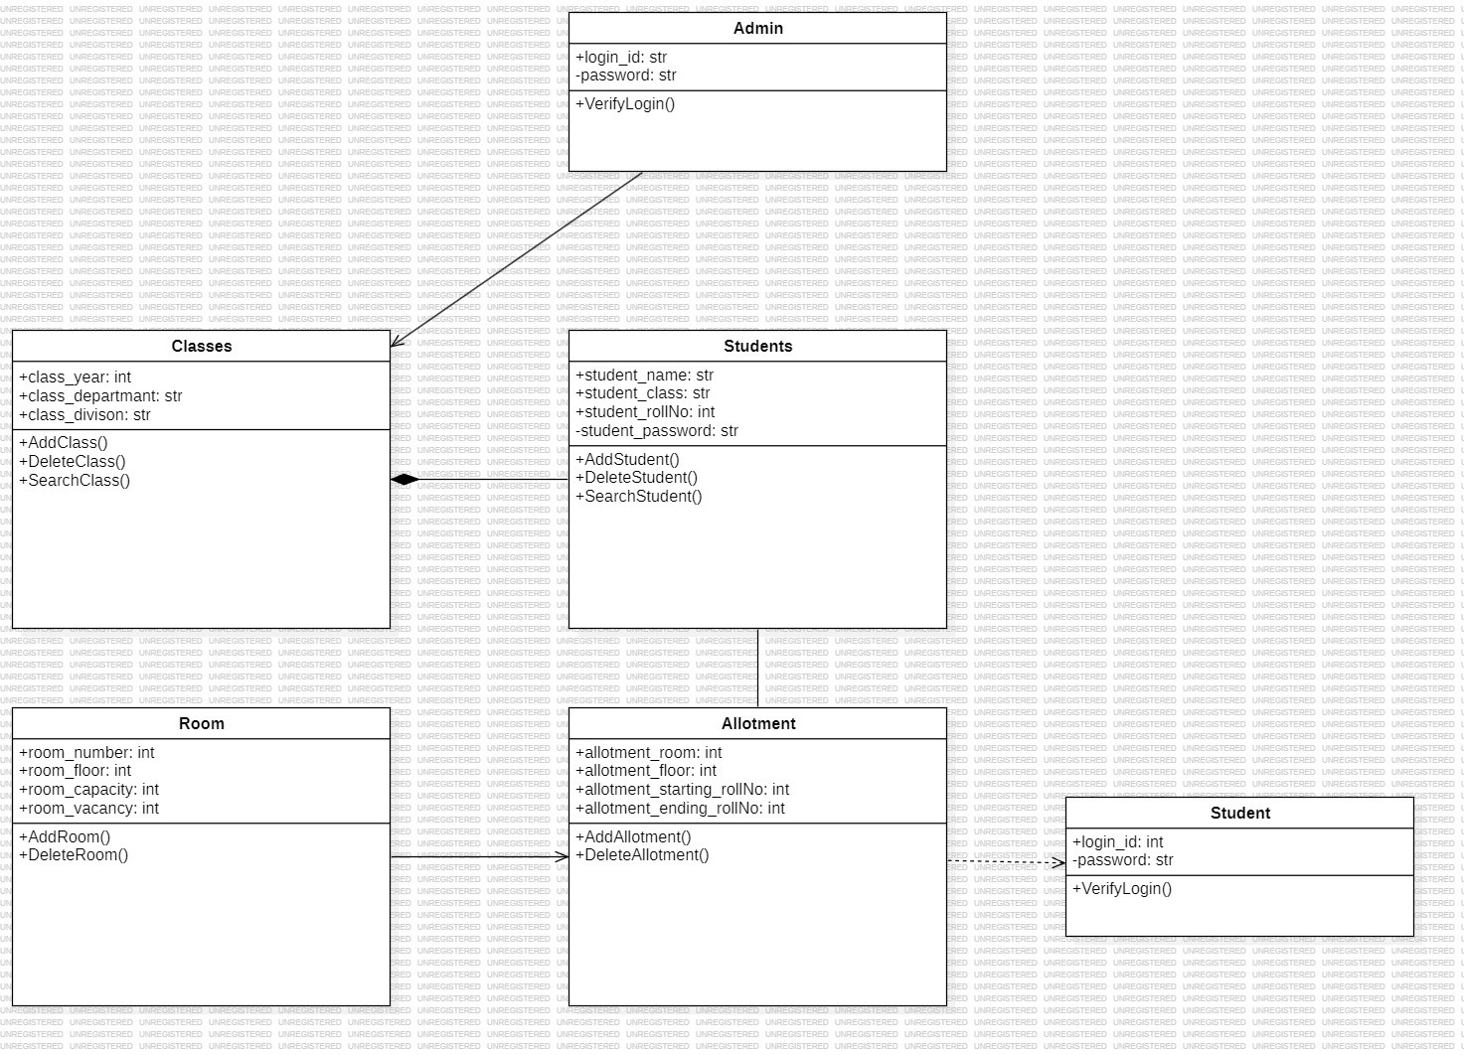
CLASS DIAGRAM
9

Slide 11
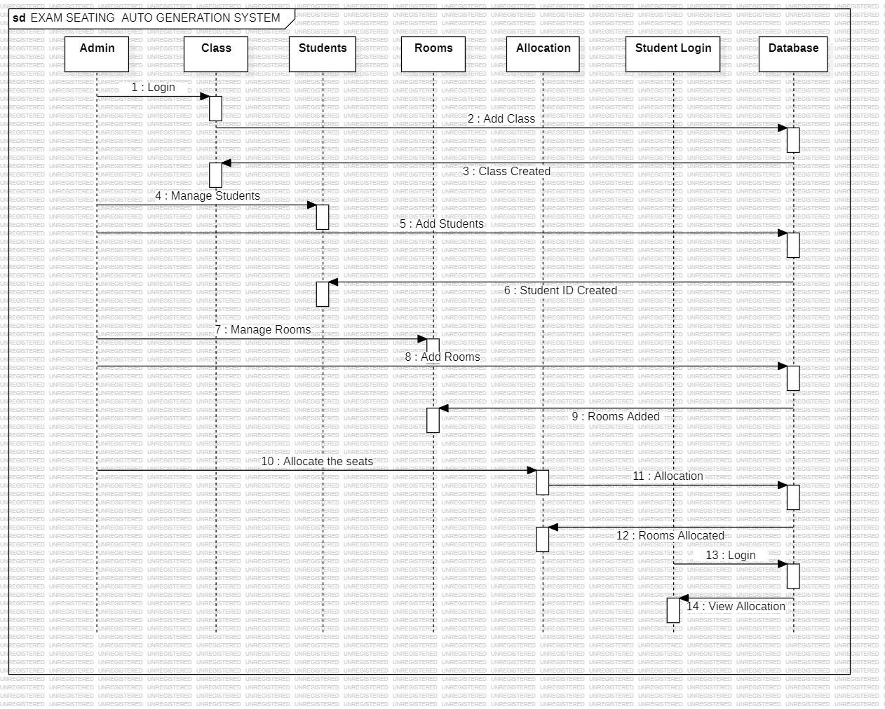
SEQUENCE DIAGRAM
10

Slide 12
ALGORITHMS
11
Technique:
Iterative Allocation: The program iterates over each room and allocates students to seats one by one.
Algorithm:
Input Collection: First, the program collects input from the user regarding the number of departments, their names, and the range of roll numbers for each department.
Seating Arrangement:
It then iterates over each room.
For each room, it prepares a list of students from all departments and sorts them based on their roll numbers.
It allocates students to the current room sequentially from this sorted list until the room reaches its maximum capacity.
Allocation is done in ascending order of student roll numbers.
Output Display:
As the allocation progresses, the program displays the seating arrangement for each room, showing the room number, student number, and department.
It continues this process until all students are allocated to seats or all rooms are filled.

Slide 13
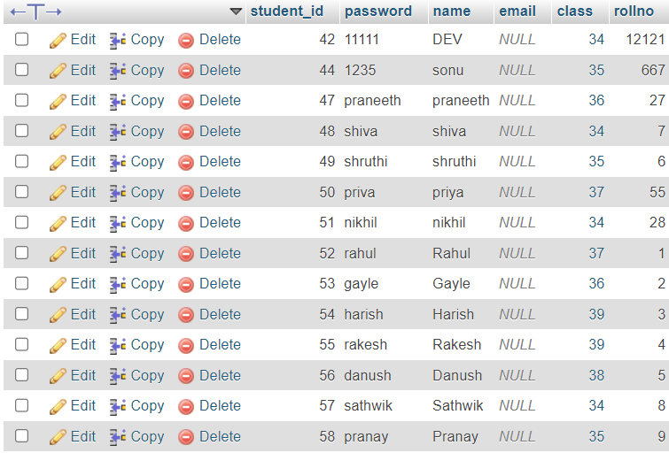
DATASET
12

Slide 14
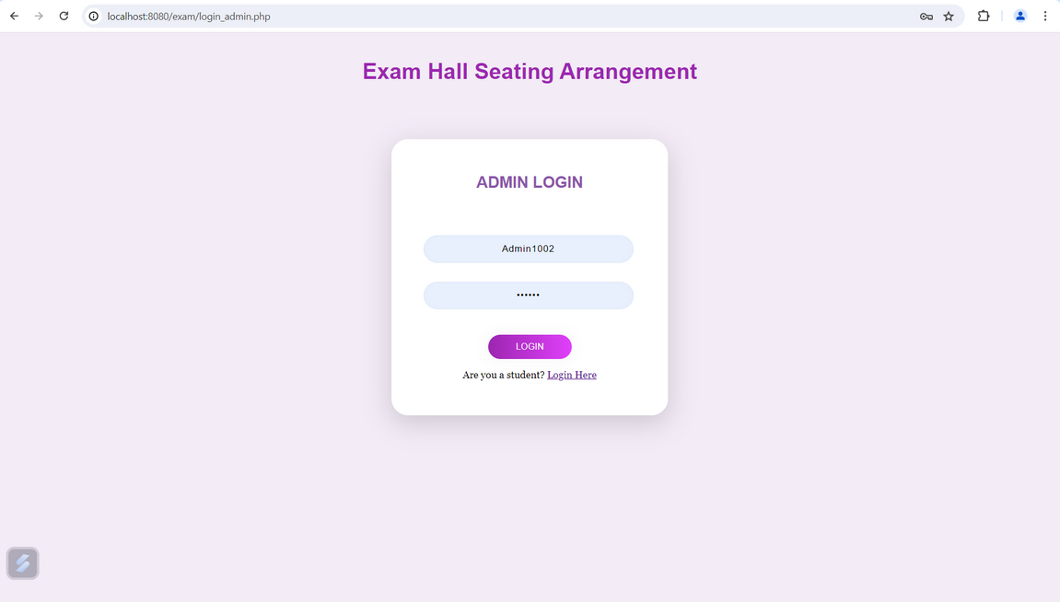
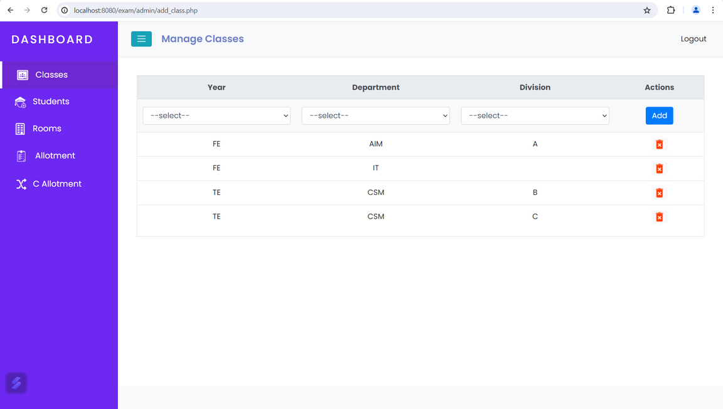
SCREENSHOTS AND PROJECT EXECUTION
13

Slide 15
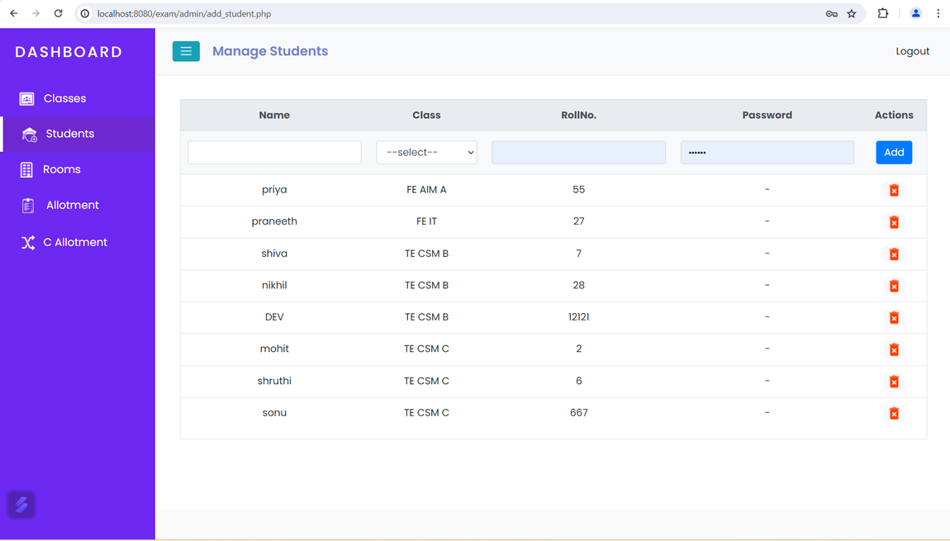

SCREENSHOTS AND PROJECT EXECUTION
15

Slide 16
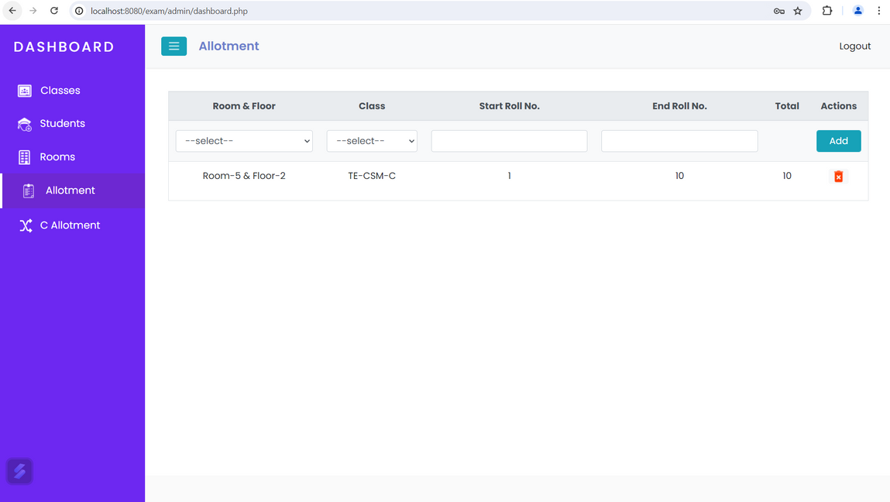
15
SCREENSHOTS AND PROJECT EXECUTION

Slide 17
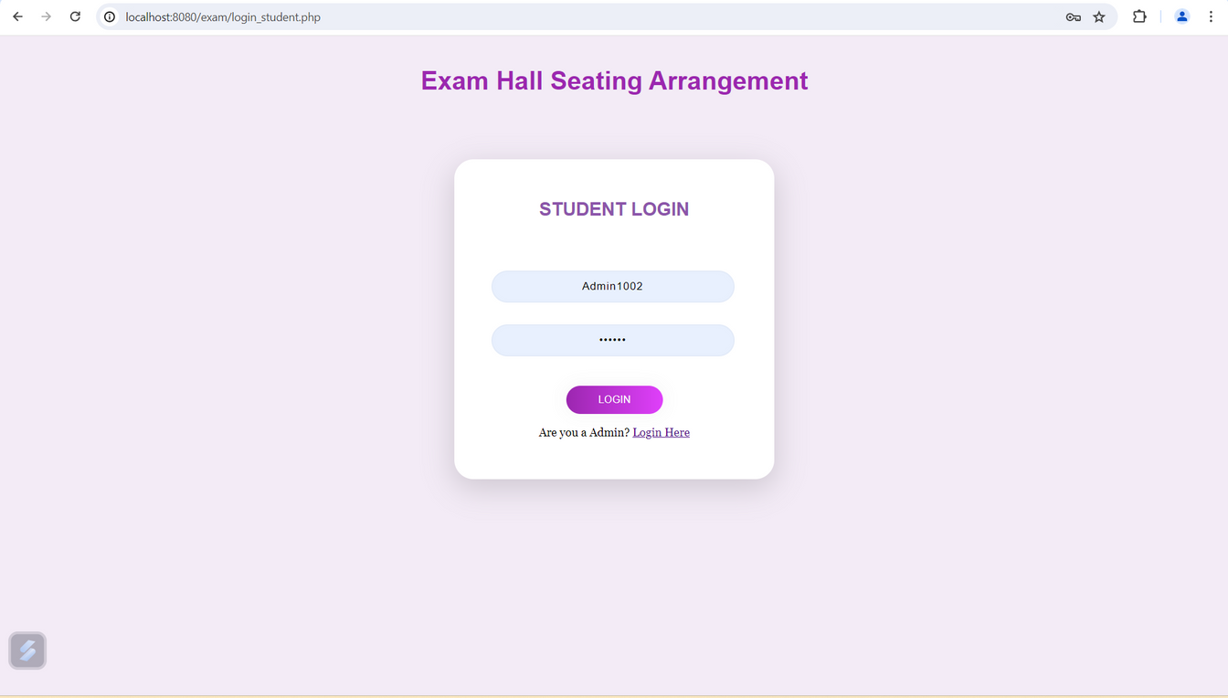
16
SCREENSHOTS AND PROJECT EXECUTION

Slide 18
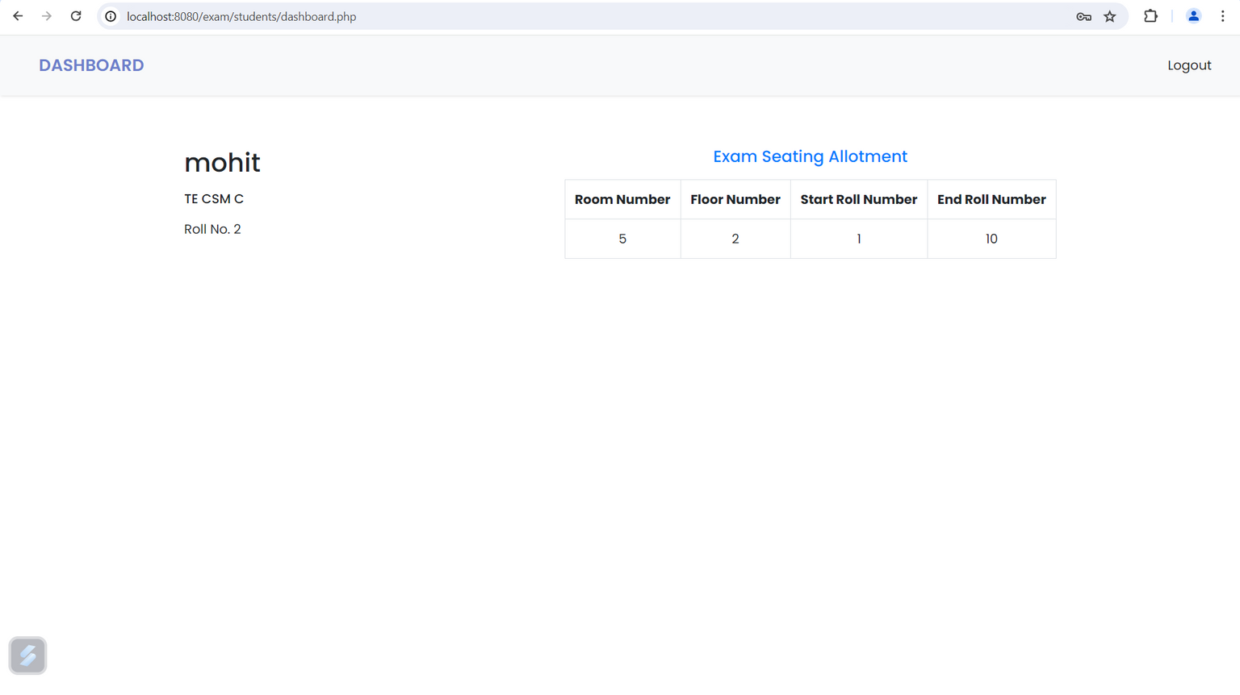
RESULT ANALYSIS
17

Slide 19
PERFORMANCE METRICS
18
Process Efficiency: Measure the time it takes to complete tasks before and after the transition. This could include the time it takes to process orders, handle customer inquiries, or complete administrative tasks.
Accuracy: Compare the accuracy of data entry and output before and after the transition. Look for any discrepancies or errors that may have occurred during the manual process and determine if the digital process has reduced these errors.
Cost Savings: Calculate the cost savings achieved through the digital process. Consider factors such as reduced labor costs, decreased paper and printing expenses, and savings on storage space.
Productivity: Assess the productivity of employees involved in the process. Measure the number of tasks completed within a specific time frame and compare it to the manual process. Look for any bottlenecks or inefficiencies that may be impacting productivity.

Slide 20
CONCLUSION AND FUTURE
SCOPE
19
Automatic exam seating system streamlines administration, enhances fairness, security, and efficiency, optimizing resources with advanced algorithms and robust security measures.
Intelligent Scheduling: Incorporate machine learning techniques to predict future exam demands, optimize exam schedules, and anticipate seating arrangement requirements based on historical data and trends.
Mobile Applications: Develop mobile applications for both administrators and students, providing convenient access to exam schedules, seating assignments, and notifications. Enhance the user experience and accessibility of the system.
Real-time Monitoring and Alerts: Implement real-time monitoring capabilities to detect and respond to potential issues during exams, such as seating discrepancies or room disruptions. Enable administrators to receive alerts and take immediate action when necessary.

Slide 21
20
ANY QUERIES?

